Slide 1
Housing and Education
Tacoma Housing Authority

Slide 2
Housing and Education are Inextricably Linked
There are 3,965 school aged children in THA subsidized housing.
This is about 40% of household members in THA's programs
Roughly 13% of the Tacoma Public Schools population (TPS population: 30,906)
Nearly 60% of THA’s customers have enrolled in some college.
Only 15% have completed a post-secondary credential.
2,659 Tacoma Public School children are homeless or unstably housed (McKinney-Vento), 407 of those children are unaccompanied young people
Tacoma Public Schools has the highest number and percent of McKinney-Vento students in Washington State.
Notes:
THA college data from Jess’s CHAP report

Slide 3
Education Goals
THA’s students will graduate high school
THA’s students will enroll in post-secondary degree or certificate programs
THA’s adult customers will have the support they need to pursue their own educational goals
TPS students will be housed, and they will graduate high school
Tacoma’s homeless system will have room for homeless and unstably housed college students
Notes:
With these data in mind, we set goals with our educational partners.

Slide 4
K-12 Housing Programs

Slide 5
Prioritizing McKinney-Vento Students: A Brief History
McCarver Housing Program
Elementary School Housing Program
Prioritizing all MV students for all THA housing
50 subsidies for families enrolled in and willing to stay at McCarver Elementary School.
Improved student stability but finding housing in the neighborhood was challenging.
1:25 person case management provided by THA was unsustainable for scaling.
Expanded eligibility to all TPS elementary school children and their families.
Housing was administered through County’s homeless system.
Services were leveraged through County funding system.
TPS can refer MV students for any tenant-based or portfolio vacancy.
All supportive services are provided by TPS.
Evolved to a model where each partner is providing realistic and sustainable resources toward the end goal.
Notes:
evolution to a model where each partner is providing realistic and sustainable resources toward the end goal.

Slide 6
College Saving Accounts (CSA)
Every child in THA’s portfolio is eligible for a College Savings Account.
THA partners with the Washington Student Achievement Council to seed a $500 deposit into a state-managed 529 account.
Family and youth engagement around financial education, college and career navigation, and social-emotional learning.
There are 288 students currently enrolled.
25 students that have graduated high school and requested their payout.
How are the 25 graduates using their funds?
13 intend to go to college
7 intend to go to trade school
5 intend to enter directly into the workforce
Students’ plans of use for CSA funds:
In order of preference:
housing costs
transportation costs
utility expenses
program/school fees
internet/tech

Slide 7
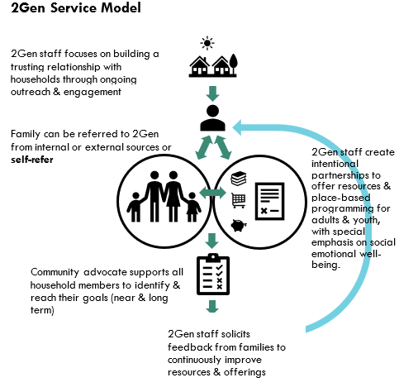
We provide social-emotional supports and services to THA households.
“I'm happy more. I succeed a lot: I work on myself enough, I’ve gotten in counseling, and I see my growth. I see where I needed to change a lot to get to where I'm at today. I’m still working on some goals and I know if I push myself I can do it. It took a year of working on my son first, making sure he was alright. Now that we're in 2022, it feels like everything's coming together.”
- 2Gen Participant
Notes:
While housing, in itself, is a platform to improve health outcomes, which Tamara will share more research about, oftentimes individuals and families need additional support to reach their personal goals and aspirations and improve their overall well-being
This is where THA’s social service wing comes in to provide housing stability, social-emotional, and economic supports.
In our family properties, we have recently deployed the 2Gen service model, an evidence-informed approach to delivering services and supports.
families lead their own goal-setting and achievement process and work as a multi-generational unit towards their self-defined vision of success
then referrals, engagement opportunities, youth activities, and relationship building/enrichment activities
In our senior and disabled properties, we provide a variety of activities that support social-emotional well being and overall health, including:
Chair yoga, fall prevention, nutrition, cooking on a budget, meditation, rehabilitative therapy, fitness, financial counseling, support groups (for example, for LGBTQ seniors), and crafting
Our embedded staff make a point to get to know residents in an informal way which creates natural support networks and interest in these offerings

Slide 8
Post-Secondary Housing Programs

Slide 9
College Housing Assistance Program
Beginning in 2014, THA used MTW flexibilities to provide 75 subsidies for homeless or near homeless students.
Later, THA used MTW flexibility to buy down rents at properties near two college campuses.
Subsidies were fixed, not income-based.
To be eligible, participants had to already be enrolled in and attending school.
Students had to remain in school to remain eligible for the housing.
Assistance was limited to 5 years or 6 months post graduation (whichever came first).

Slide 10
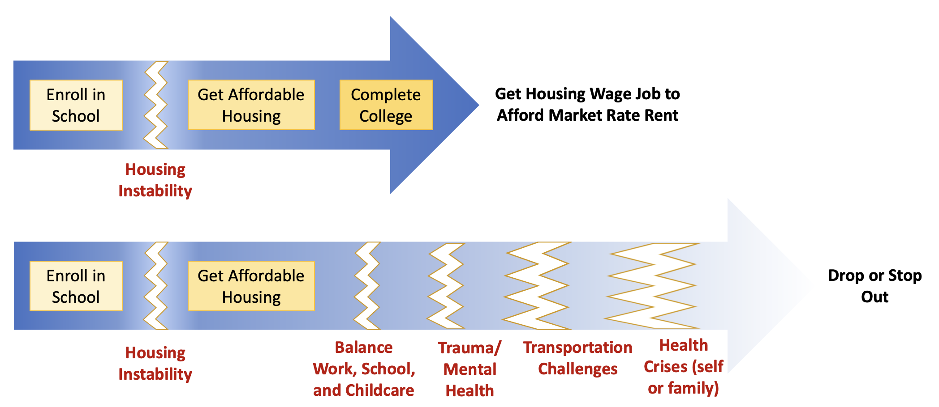
Hypothesis vs Reality

Slide 11
Lessons Learned
Ability to Secure Housing
Changes in Income
Loss of Assistance
Only half approved for a voucher completed the steps to receive a voucher.
Of those, only half secured housing.
Males and African American/ Black students were least likely to secure housing.
Students with minimal income faced additional barriers.
Avg tenant share of rent was $520.
Landlords require tenants have 2-3x the rent in income.
CHAP participants were less likely to experience an increase in income compared to other THA clients.
Only 37% increased income over the course of the program.
BIPOC households in CHAP were disproportionately less likely to experience an increase of income.
52% of CHAP voucher holders had their housing assistance terminated for not meeting continued eligibility requirements (e.g., remaining enrolled full-time, making academic progress, maintaining a 2.0 GPA).
17% graduated.
Notes:
some students reported expanding their coursework and taking on more debt to retain housing

Slide 12
Data-Driven Program Refinements
Tenant-based participants were transitioned to income-based rents (deeper subsidy).
Removed time limits on assistance.
Enrollment requirements were removed – allowing students to pursue programs at other colleges.
Expanded eligibility for property-based subsidies to all low-income households (potential students).
Invested in the Pierce County homeless system to make it large enough to accept students. Leverages service funding from the County.
Working with existing THA customers to remove barriers to enrollment in post-secondary degree and certificate programs.
Review data
Design/ Redesign
Implement
Notes:
partnering with specific colleges innately limits students academic/professional options to those at the college. Poses an additional barrier for highly competitive programs like nursing.

Slide 13
Takeaways
Solutions to student homelessness and housing insecurity aren’t soundbites.
Homeless college students are having similar experiences to other low-income young people and families.
Homeless K-12 students have caring adults with their own individual needs.
MTW allows for piloting solutions and scaling up or down based on longitudinal data.
Qualitative data (hearing directly from customers) was just as important as quantitative data (numbers) in evaluating program success and challenges.
Positive housing and educational outcomes rely on other systems.
Access to physical and mental health supports.
Access to transportation.
Investment in fair housing resources to address racial discrimination.
Funding supportive services to navigate the systems.
Notes:
focus on homeless *students* ignores homeless people who also want to pursue higher ed. To support the development of and success of students, we have to house *people*.

